Slide 1

Super Forecasting Project
Group 2: Nodir Khamdamov
Rupali Madishetty
Julia Toler
Naman Sharma

Slide 2


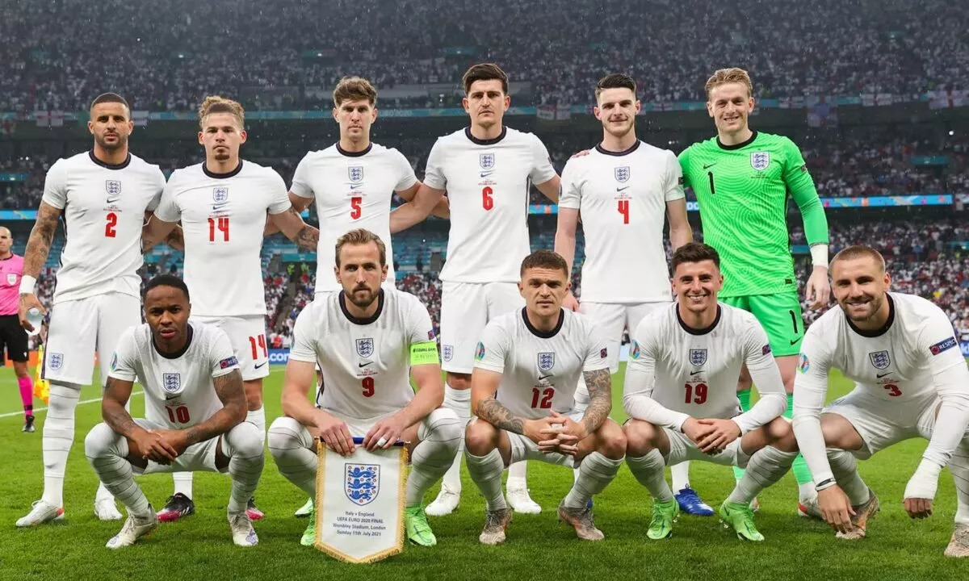
How far will the England National Team advance in the 2024 European Football Championship?

Slide 3
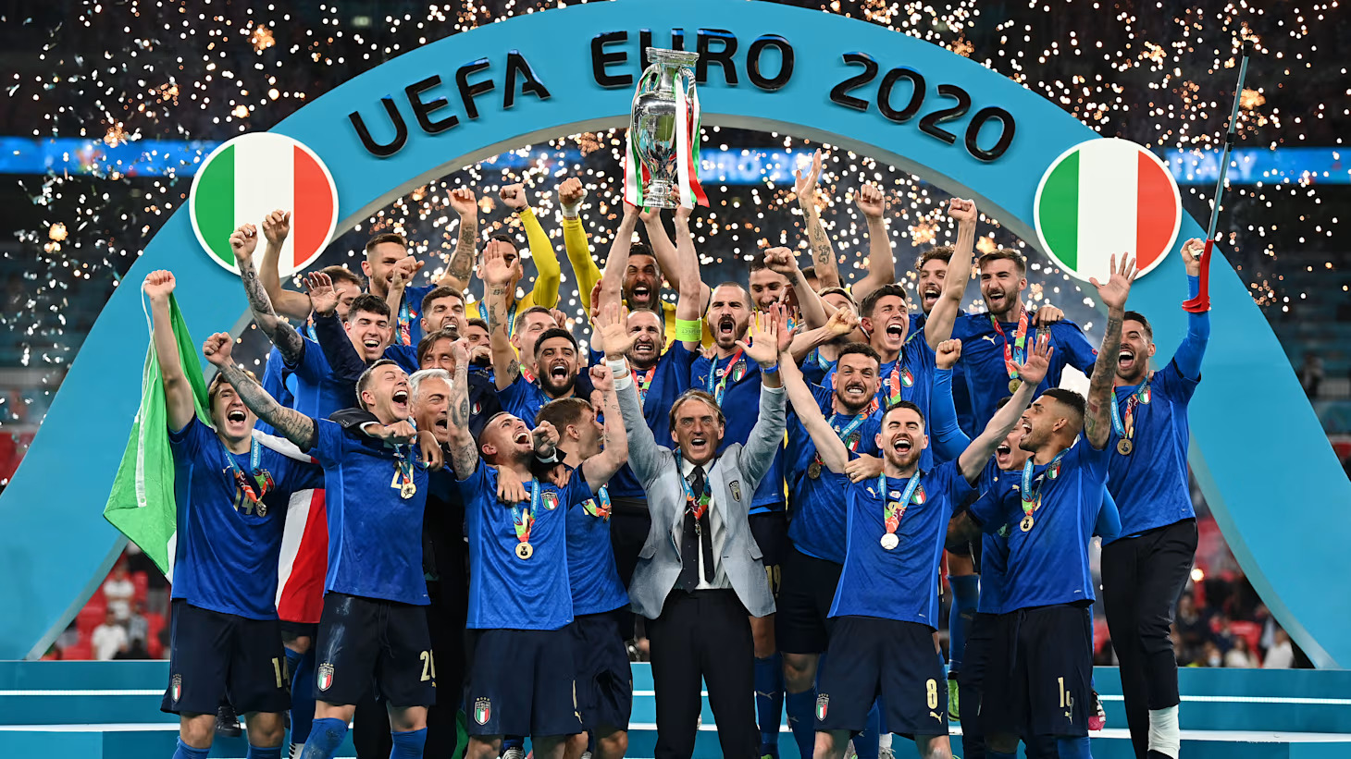
UEFA European Championship
Quick facts:
The second most popular
Every 4 years
24 out of 54 teams
The Henri Delaunay Trophy

Slide 4
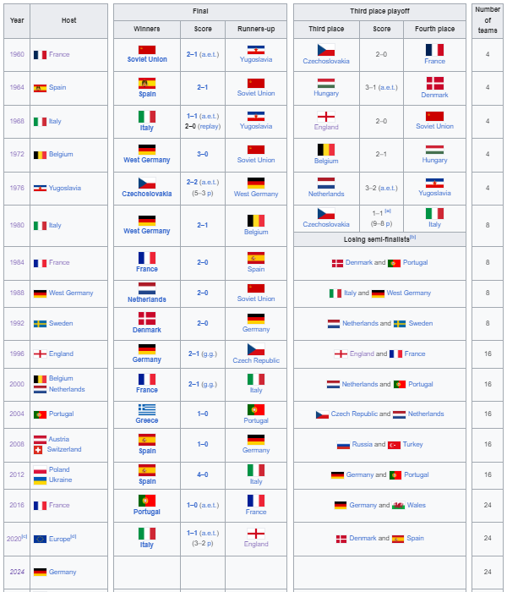
Results of UEFA European Championship finals

Slide 5
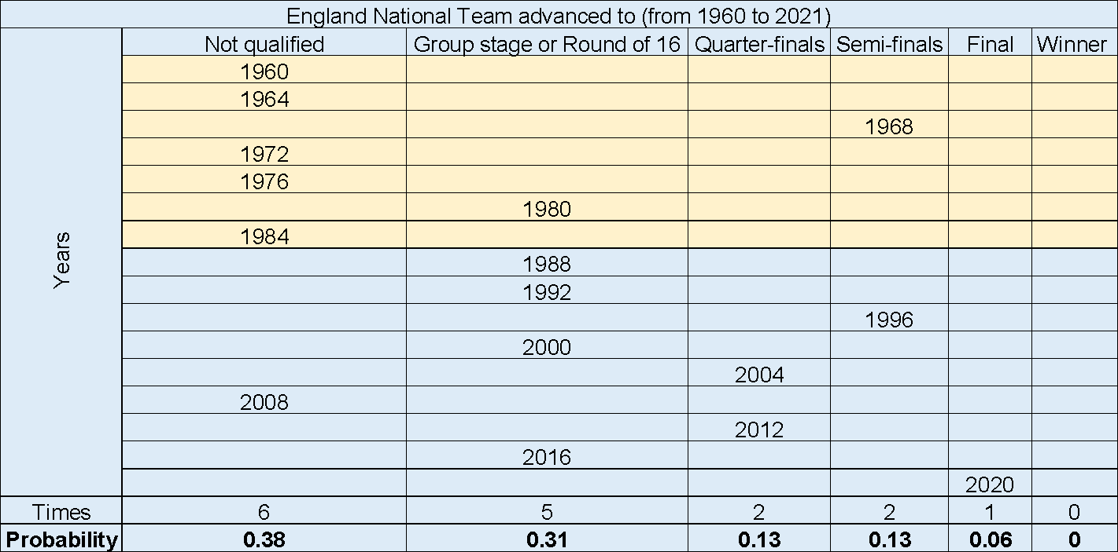
Setting up a Bayesian prior
How far has England National Team advanced in each previous tournaments?
Not relevant!

Slide 6
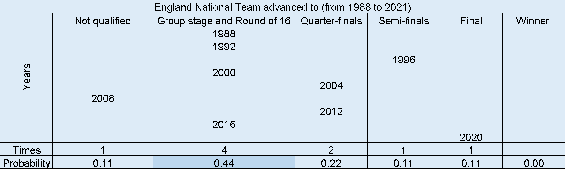
How far has England National Team advanced in each previous tournaments?
Bayesian prior (P0)

Slide 7

Cluster Questions
Rankings
Manager’s experience
Players’ effect

Slide 8
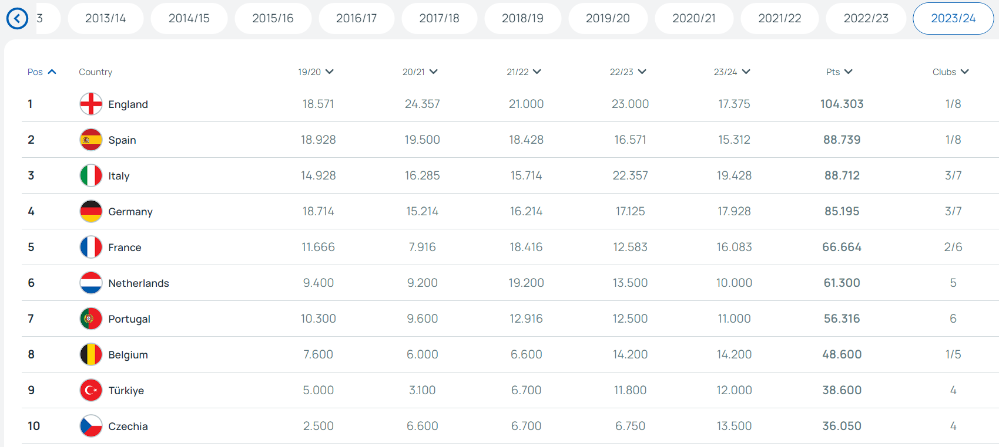
Team’s rankings
Top 3 since 2002
Number #1 in the last 3 years

Slide 9
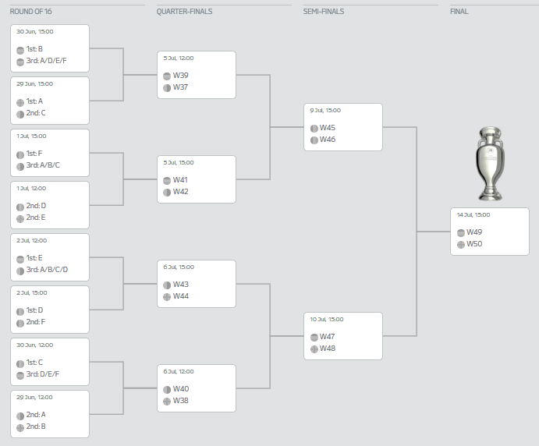
Rankings’ role
No major change in rankings
No obvious relation between rankings and team’s success
No potential impact on position change

Slide 10

Conclusion on Rankings effect
To Group stage or Round of 16 with Chances about even (P1=46%)

Slide 11
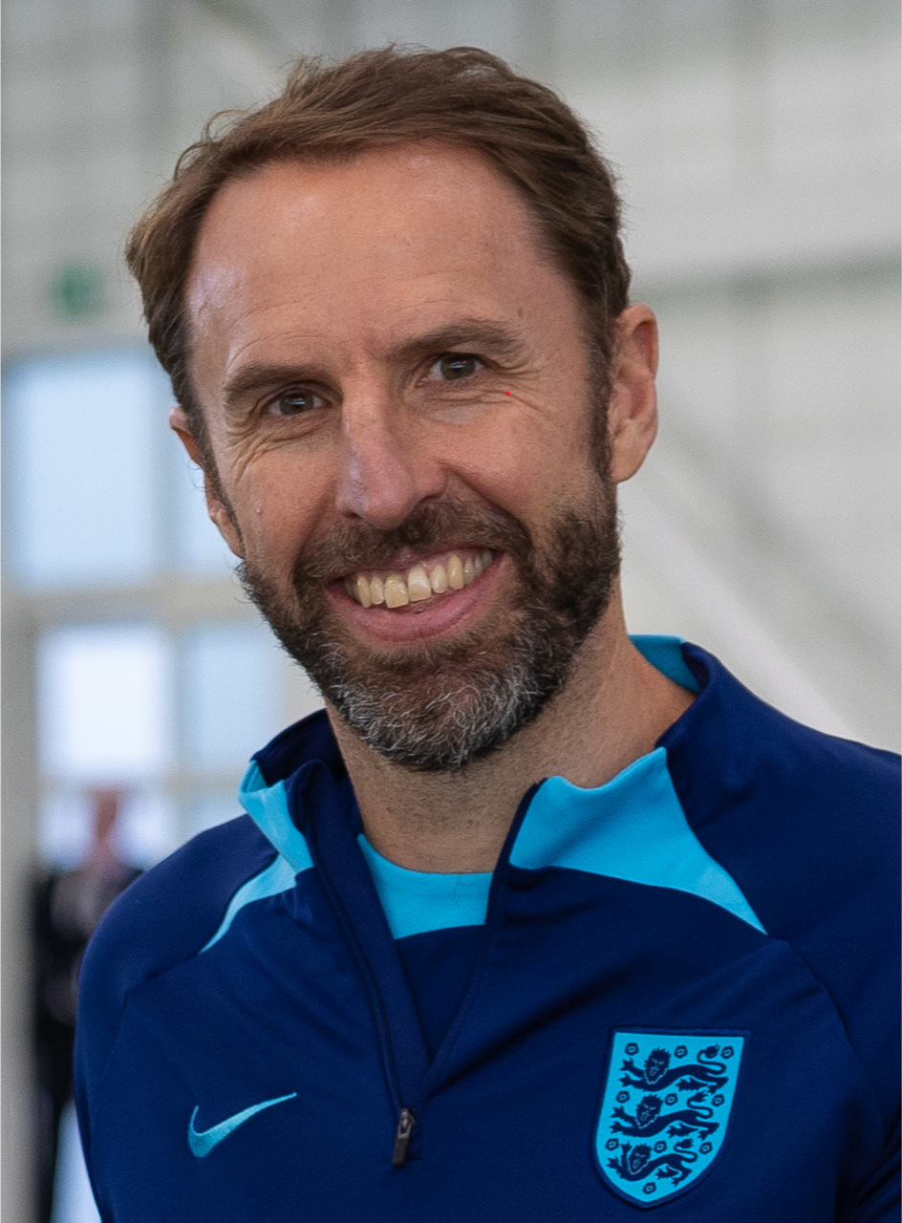
Manager’s experience
Gareth Southgate, team manager since 2016
EuroCup 2020 final
Semi-final of a World Cup 2018
Top of EuroCup 2024 qualification group

Slide 12

Conclusion on Manager’s Effect
To Quarter-final with Probable chance (P2=72%)

Slide 13
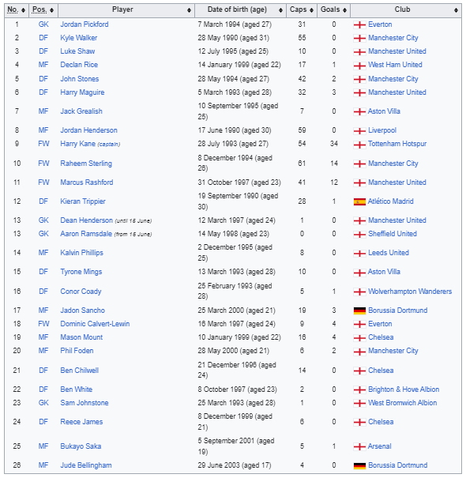
England’s UEFA Euro 2020 squad

Slide 14
England’s possible UEFA Euro 2024 squad*
Goalkeepers: Jordan Pickford, Aaron Ramsdale, Jack Butland.
Defenders: Kyle Walker, Kieran Trippier, John Stones, Harry Maguire, Ezri Konsa, Joe Gomez, Luke Shaw.
Midfielders: Declan Rice, Kobbie Mainoo, Jude Bellingham, James Maddison, Trent Alexander-Arnold, Jordan Henderson.
Forwards: Bukayo Saka, Harry Kane, Phil Foden, Ivan Toney, Marcus Rashford, Jarrod Bowen, Anthony Gordon.
*- BBC Sport editor Phil McNulty’s forecast

Slide 15
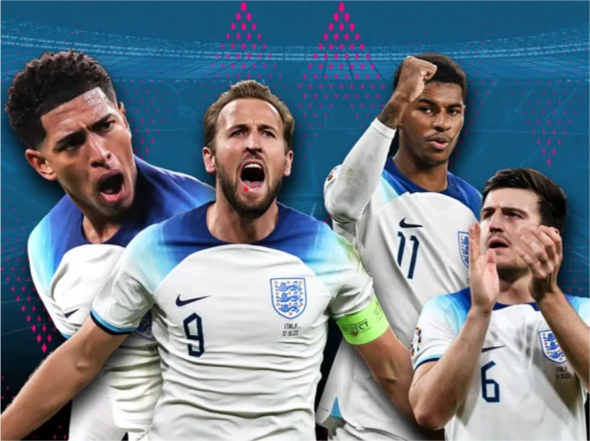
Outstanding players
Kane, Foden, Belligham are among Top #11 goal scorers
Saka are one of the best wingers
Declan Rice is the most expensive British player
Kyle Walker is now one of the most experienced
Many other star players
Conclusion on players’ effect:
To Semi-final with Probable chance (P3=74%)

Slide 16
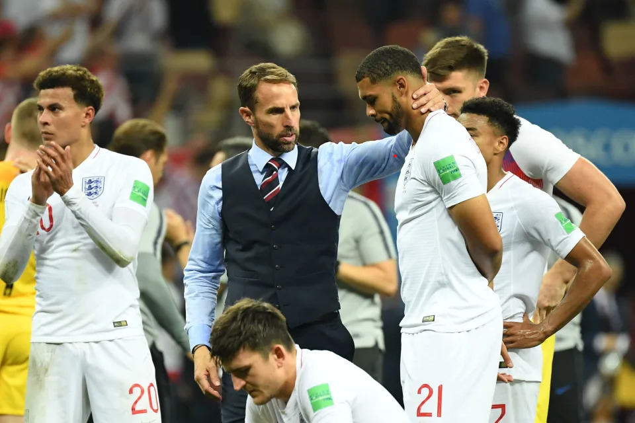
Overall Conclusion
Always unpredictable
Favorable group fixture
Best team of excellent players
Record-breaking coach
Top ranked team
Vulnerability over other favorites
The team will advance to Semi-final with Probable chance (P=74%)

Slide 17

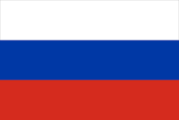
United States Vs. Russia
Will there be a lethal confrontation between the national military forces of Russia and the United States before December 31, 2024?

Slide 18
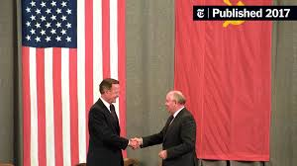
US vs. Russia Overview
Three notable clashes
Democratic Party in power during two
Negotiations of peace
Geopolitical events
There has never been a “lethal” confrontation
Notes:
There has never been a “lethal” confrontation between the US and Russia
There have been three cold wars
The Democratic Party in power during two
Negotiations were always made
Geopolitical events always increased tensions

Slide 19
Clashes Between US and Russia
Conflict | Year | Negotiations | Party In Office | USSR
Korean and Vietnam War | 1950 | UNSC Discussions | Truman/ Democratic | Stalin
Cuban Missile Crisis | 1962 | Public Agreement - ban missiles on Cuba | JFK/Republican | Kruschev
Afghanistan War | 1978 | SALT II Treaty, 1979 | Carter/ Democratic | Gorbachev

Slide 20
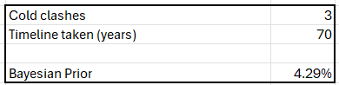
Bayesian Prior
How many cold wars occurred between the US and Russia over the past 70 years?
3/70 → 4.29%

Slide 21

Cluster Questions
US Elections 2024
Russia-Ukraine War
Lethal Confrontation History

Slide 22
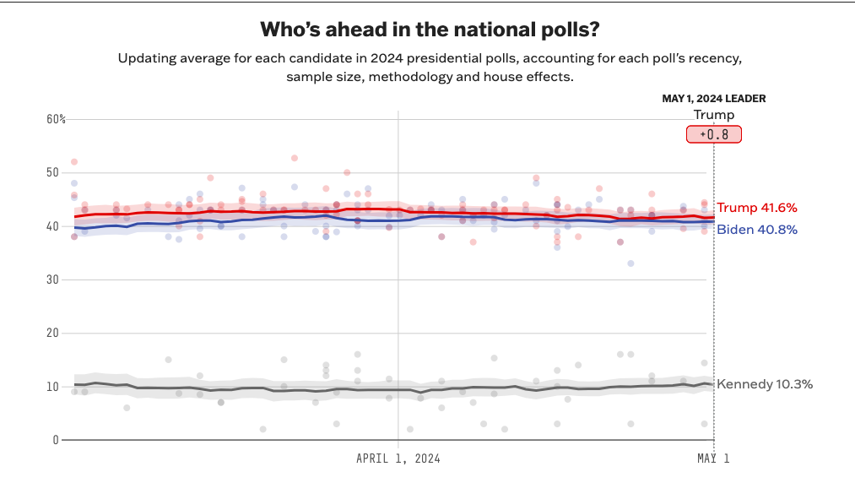
US Elections - 2024
Will democratic party continue to be in power and would that increase tensions between US and Russia?

Slide 23
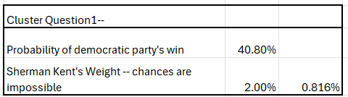
Democratic party win is 40.8% (backed by Projects 538)
US-Russia Confrontation 2% (basis possible policy changes)
P1 = 0.816%

Slide 24
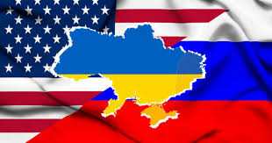
Russia - Ukraine War
Will there be Ukraine's defeat by 2024 and an increase in tensions?
Ukraine’s defeat by 2024 is most probable as per BBC News.
US Support: Tension Increase
Notes:
US has been supportive towards Ukraine thereby the defeat can possibly increase tensions between US and Russia.

Slide 25
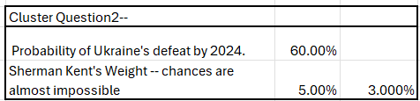
Ukraine Defeat: Tension Likely 60%
Lethal Confrontation Unlikely→ 5%
P2 = 3%

Slide 26

Lethal Confrontation History
Has there ever been any lethal confrontation between two nuclear superpowers in the history?
Never, but if it did then the world as we know it could end.

Slide 27
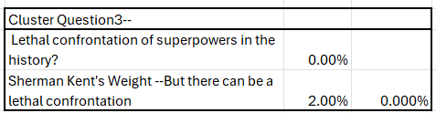
Highly unlikely lethal confrontation; probability 2%.
P3 = 0%

Slide 28
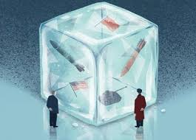
Conclusion
Bayesian Prior + P1 + P2 + P3 → 4.29% + 0.816% + 3% + 0%
= 8.1%
Almost impossible but there is always a chance.

Slide 29

Dow Jones
Stock market index
Established in 1896
Comprises 30 large-cap stocks
Reflects US economic health
Widely used investment benchmark

Slide 30
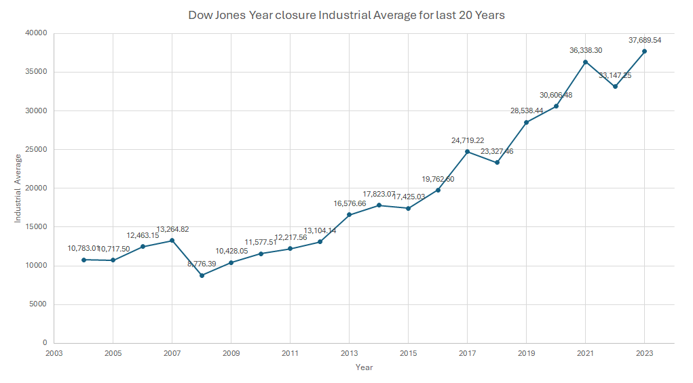
Dow Jones Industrial Average finish 2024 higher than 42,000?

Slide 31
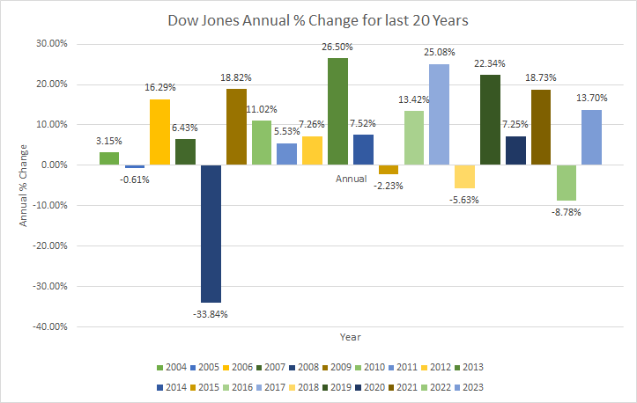

Slide 32
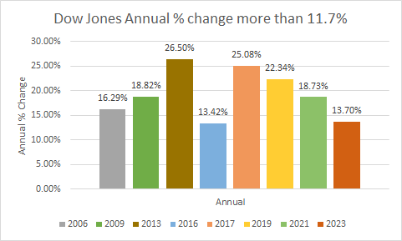
Bayesian Prior
2023 year closure 37689.54
Current average 37,880.35
11.7 % change required
Only 8 times achieved
40%

Slide 33
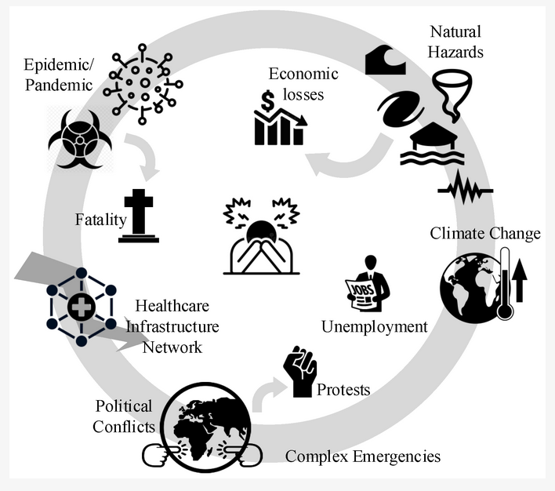
Cluster Questions
Geopolitical Events
Technological Developments
Natural Disasters and Pandemics
Elections
Market sentiment

Slide 34
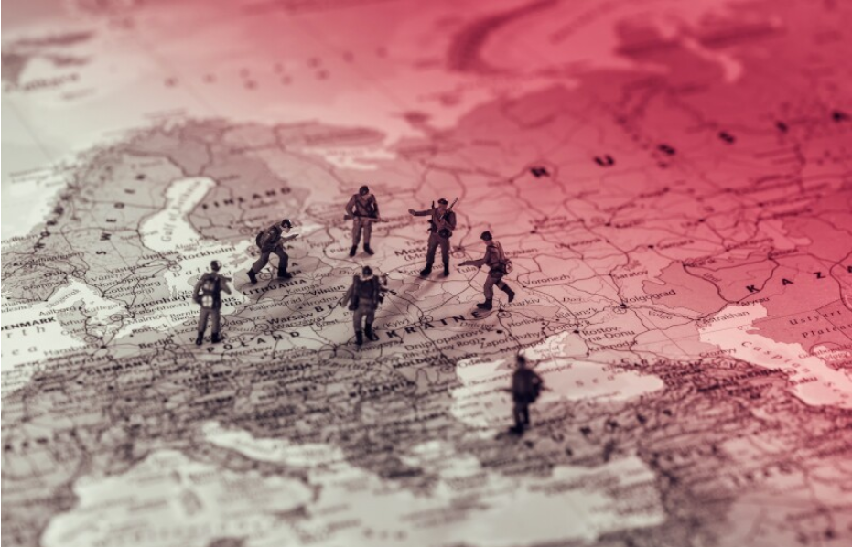
1) Geopolitical Events
Supply Disruptions
Investor Sentiment Shifts
Risk Premium Increases
Demand Fluctuations
Currency Volatility Rises

Slide 35
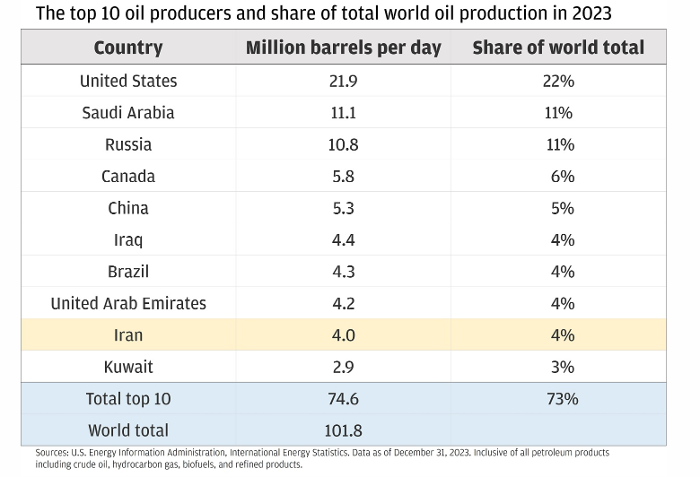
Nearly a third of global oil supply.
Strait of Hormuz and the Suez Canal
Volatility in oil prices
Concerns about supply disruptions
Influence diplomatic relations and foreign policy decisions

Slide 36
10 such conflicts.
Average 2.47% decline.
5 % decline.
S.NO | Market Shock Events | Event Date | One Day | Total Drawdown
1 | Madrid Bombing | 03-11-2004 | -1.50% | -2.90%
2 | London Subway Bombing | 07-05-2005 | 0.90% | 0.00%
3 | Boston Marathon Bombing | 4/15/2013 | -2.30% | -3.00%
4 | Bombing of Syria | 04-07-2017 | -0.10% | -1.20%
5 | North Korea Missile Crisis | 7/28/2017 | -0.10% | -1.50%
6 | Saudi Aramco Drone Strike | 9/14/2019 | -0.30% | -4.00%
7 | Iranian General Killed In Airstrike | 01-03-2020 | -0.70% | -0.70%
8 | U.S. Pulls Out of Afghanistan | 8/30/2021 | 0.40% | -0.10%
9 | Escalation of Russia/Ukraine Conflict | 2/17/2022 | -2.10% | -6.80%
10 | Israel-Hamas War | 10-09-2023 | 0.30% | -4.50%
 | Average |  | -0.55% | -2.47%

Slide 37
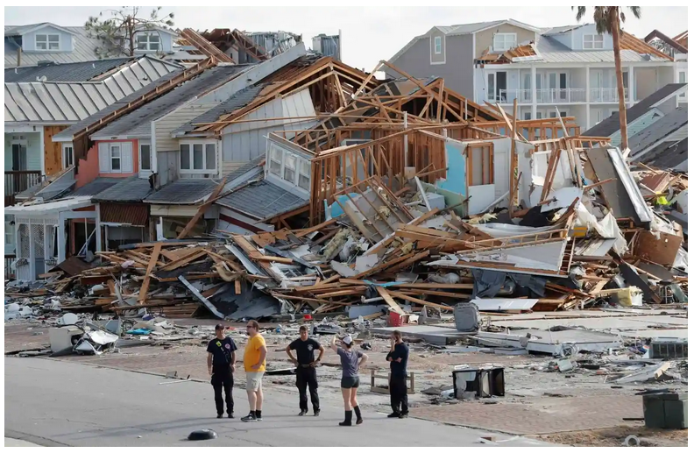
2) Natural Disasters and Pandemics
Insurance Industry Pressure
Supply Chain Disruptions
Investor Confidence Wanes
Infrastructure Damage Costs
Consumer Spending Declines
Economic Growth Stalls

Slide 38
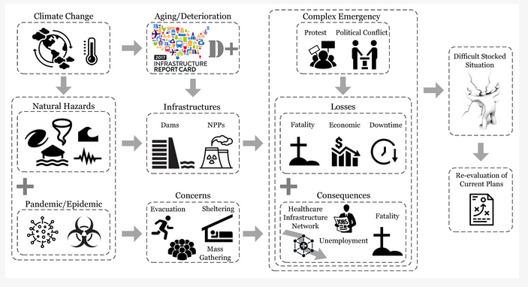
5 industries
Stanford research .5 % decline
2.5% decline

Slide 39

3) Technological Developments
Technology adoption accelerates
Digital transformation drives expansion
Innovation fuels market growth
IT efficiency boosts productivity

Slide 40
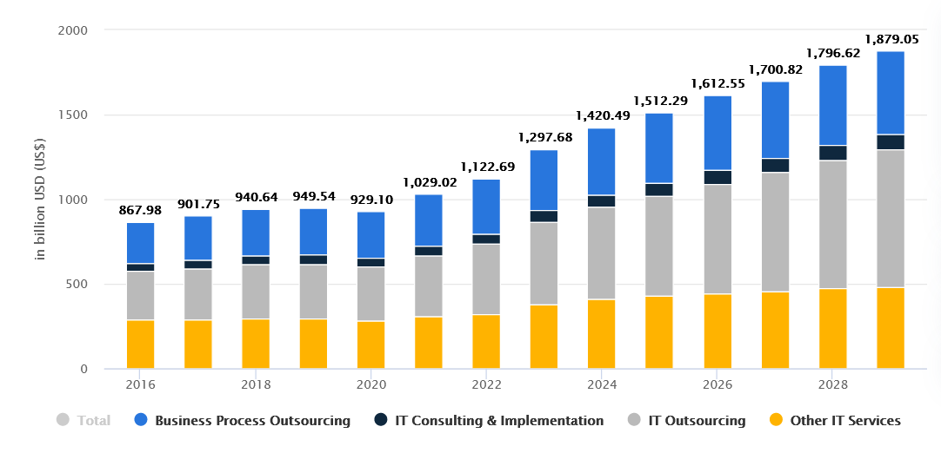
Expected growth 9 percent
Most of the companies are from IT
High spending
6 %

Slide 41

4) Elections
Uncertainty causes volatility.
Policy changes impact sectors.
Investor sentiment fluctuates.
Long-term outlook shifts.

Slide 42
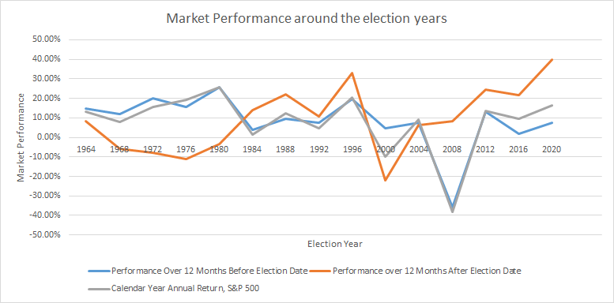

Slide 43
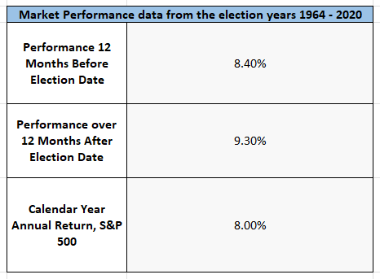
Minor increment
Not so influential
1%

Slide 44
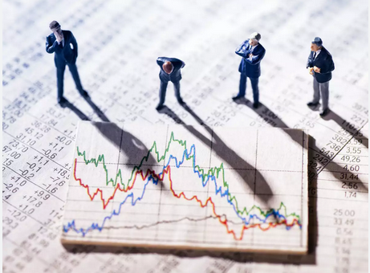
5) Market sentiment
Influence on trading behavior
Drives buying/selling decisions
Impacts asset prices
Reflects investor confidence

Slide 45
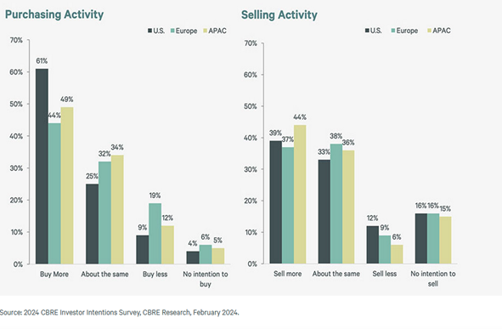
There is overall growth
People are investing
4%

Slide 46
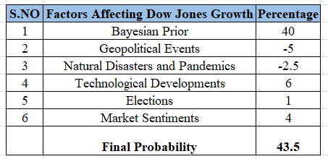

Slide 47
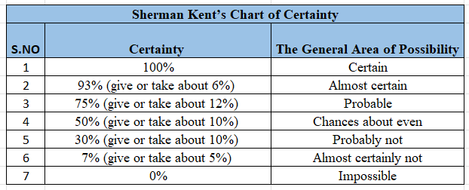
References

Slide 48
Works Cited - Question 1
England national football team - Wikipedia
England Football
https://www.uefa.com/nationalassociations/uefarankings/country/?year=2024
https://www.bbc.com/sport/football/68671206
https://www.bbc.com/sport/football/68668152

Slide 49
Works Cited - Question 2
Russian Presidential Election Info
https://www.state.gov/u-s-relations-with-russia/
https://history.state.gov/milestones/1961-1968/cuban-missile-crisis
https://history.state.gov/milestones/1977-1980/soviet-invasion-afghanistan
https://www.state.gov/u-s-relations-with-russia/
https://projects.fivethirtyeight.com/polls/president-general/2024/national/
https://www.bbc.com/news/world-europe-68778338
https://ua.usembassy.gov/our-relationship/policy-history/#:~:text=The%20United%20States%20and%20Ukraine,%2C%20aircraft%2C%20and%20agricultural%20products.

Slide 50
Works Cited - Question 3
https://www.macrotrends.net/1358/dow-jones-industrial-average-last-10-years
https://www.jpmorgan.com/insights/outlook/market-outlook/geopolitical-unrest-assessing-market-implications
https://economictimes.indiatimes.com/markets/stocks/news/how-will-the-israel-palestine-war-impact-financial-markets-is-there-any-historical-reference-to-this/articleshow/104362098.cms?from=mdr
https://www.reuters.com/markets/global-markets-middle-east-conflict-2023-10-18/
https://www.lpl.com/research/blog/middle-east-conflict-how-stocks-react-to-geopolitical-shock.html
https://www.statista.com/outlook/tmo/it-services/united-states#revenue
https://www.gartner.com/en/newsroom/press-releases/01-17-2024-gartner-forecasts-worldwide-it-spending-to-grow-six-point-eight-percent-in-2024
https://web.stanford.edu/~ishuwar/Disasters_Stocks_Current.pdf
https://www.ig.com/en/trading-strategies/impact_of_naturaldisasterandwars-231208
https://www.ncei.noaa.gov/access/billions/
https://www.undrr.org/media/48008/download?startDownload=20240428
https://www.forbes.com/advisor/investing/how-do-elections-affect-the-stock-market/
https://www.investopedia.com/terms/m/marketsentiment.asp
https://www.cbre.com/insights/reports/2024-global-investor-intentions-survey

Slide 51
Thank You!

